Slide 1
COMP6230
Expected the Unexpected
Oliver Bills
ofb@ecs.soton.ac.uk

Slide 2
So now we are all set up!
We have the tools that we need on hand
We have our intercepting proxy set up
It’s time to begin!

Slide 3
Starting out
http://robtheshop.soton.ac.uk
What can we find out from just visiting the first page?

Slide 4
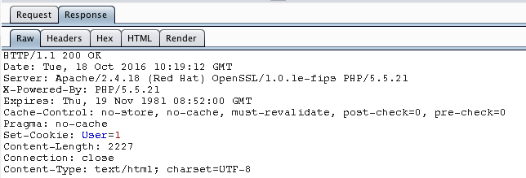
Starting out

Slide 5
Starting out
http://robtheshop.soton.ac.uk
What do we have here?
PHP
Apache 2.4
RedHat
PHP files accessed directly
No other interesting links

Slide 6
Starting out
Is the shop still open, but we just can’t get to it?
It’s likely there’ll be some clues left behind to the full shop website that we might be able to exploit
Links
Images
Resources
Comments

Slide 7
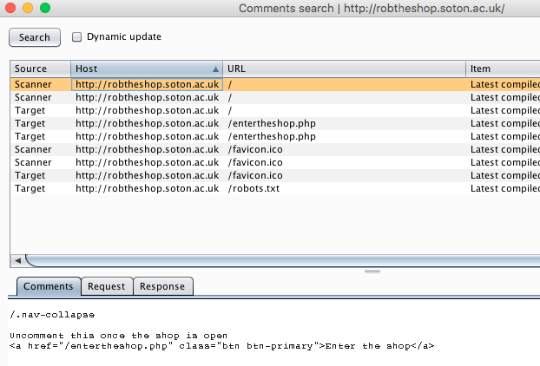
Starting out

Slide 8

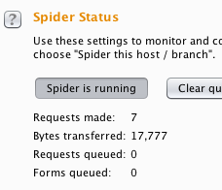

Starting out

Slide 9
Logging in
We’ve found a log in form, but we don’t have any ability to log in
What do we know?
It’s going to be using a database
What’s the first thing to try?
Can we abuse the database!

Slide 10
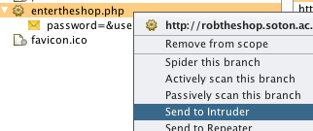
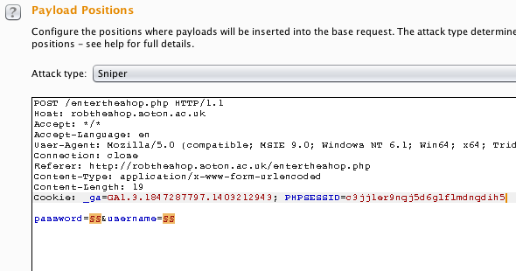
Logging in

Slide 11
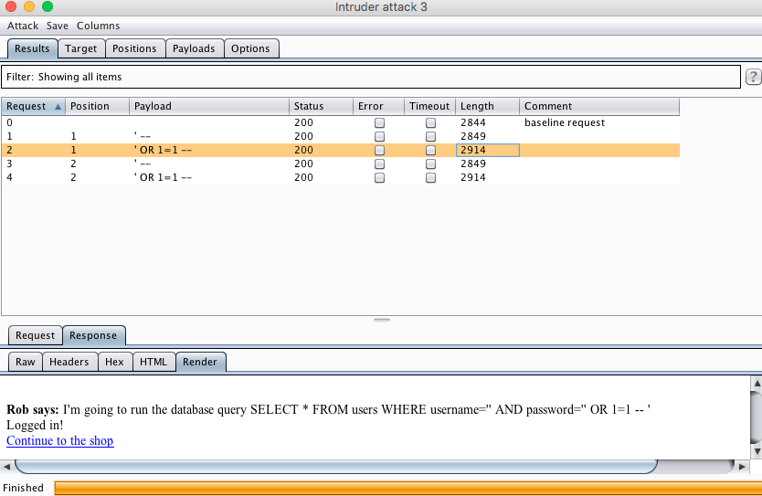
Logging in

Slide 12
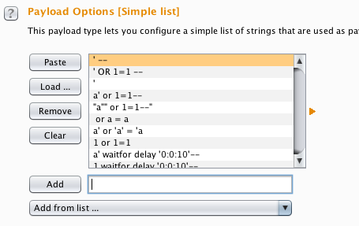
This is called fuzzing
Big lists of dodgy inputs that have been pre-compiled by people
Known SQL injection attacks
Known XSS injection attacks etc.

Slide 13
Know when you’ve succeeded
Sometimes the different response length or digest is enough
Sometimes if we are sending hundreds of responses, we want to know when we’ve been successful to identify any compromises

Slide 14
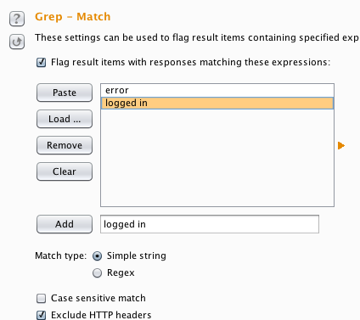
Know when you’ve succeeded

Slide 15
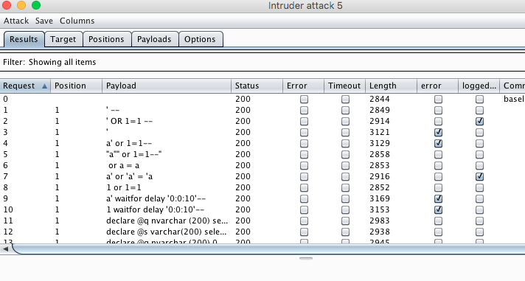
Know when you’ve succeeded

Slide 16
Opening the shop
It sounds like an admin action
So we need to try and see if we can get into the admin area
Admin areas are usually logically named
Or you can investigate the software and work it out
E.g. Wordpress is wp-admin
First of all, can we find an admin area?

Slide 17
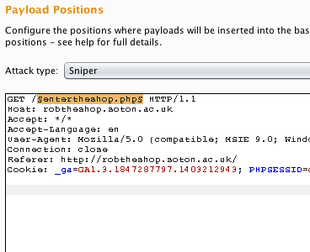
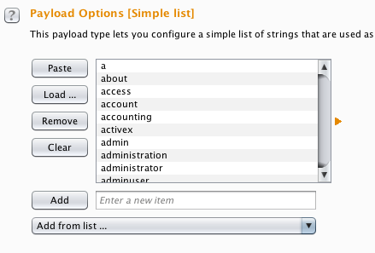
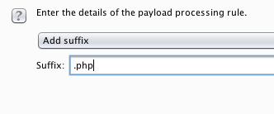
Opening the shop
Again, we can use a fuzzing list of common directories and admin scripts to see if we can find anything

Slide 18
Opening the shop
We now enter the realms of informed guessing
What do we know?
We know that there is an admin folder
We know that the filenames end in .php
We know that the site uses the term ‘item’ to refer to things in the shop from what we have seen already
We can put this all together to inform our guesses

Slide 19
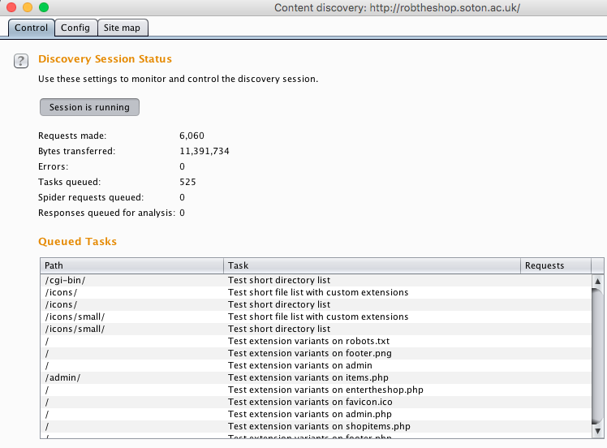
Opening the shop
Or we can let the tool do that exact process for us!

Slide 20
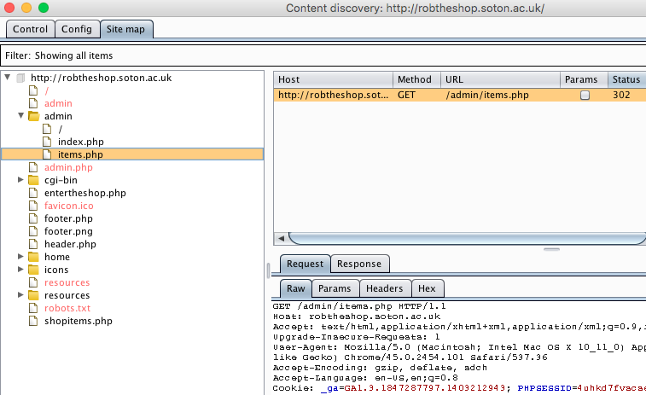
Opening the shop
Look what we’ve found
And quite a few other things too!

Slide 21
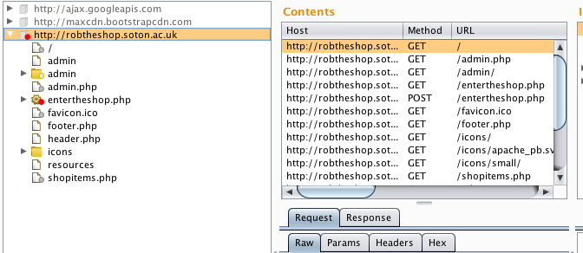
Opening the shop
Can’t remember where you were before to now see if you can buy things?
That’s when the Site Map and Request History comes in useful!

Slide 22
Not being able to claim on expenses
We want unicorns but they’re expensive
User data is the way in to a vulnerability
But what user data do we have?

Slide 23
Keeping track of where we can enter data
As a user, we can cause trouble with the data we enter
We can enter data through
The URL
GET parameters (?something=something)
POST parameters (on a form)

Slide 24
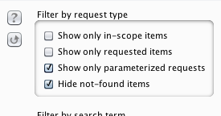
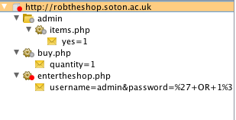
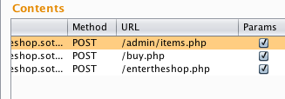
So where can we enter data?

Slide 25
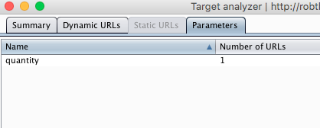
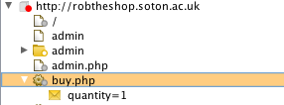
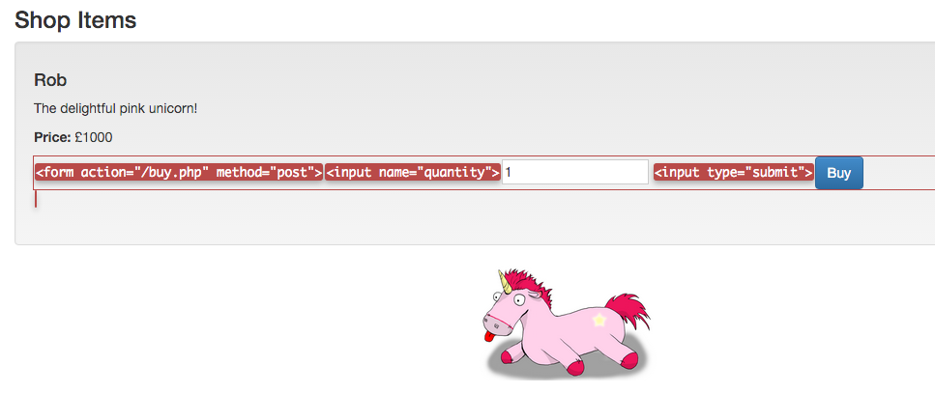
Buying the best things ever

Slide 26
XSS
Remember how it works
What happens to our HTML characters
Does a > pass through unimepeded, or get encoded
> vs &gt;
What we’re looking for
An input which is also an output
Test the waters first, nice and unsuspicious
Look at our surroundings
Look at what the system does with our input
Can we get any UNESCAPED output
Then go in for the attack
Use the XSS Cheat Sheet

Slide 27
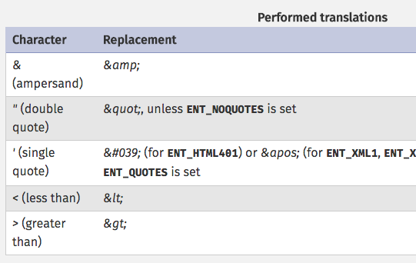
XSS
What a site should do
Input it output after being escaped/encoded
What a site shouldn’t do
Input is output as it is input
Test the special characters
& “ ‘ < and >

Slide 28
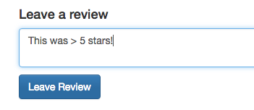

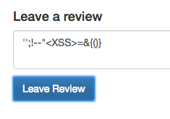
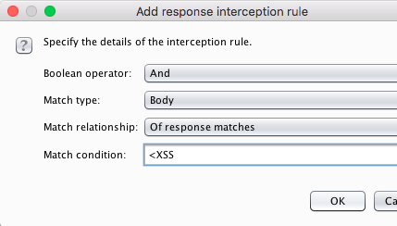
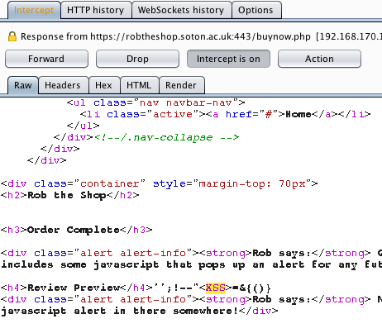

Slide 29
Cookies
Examine what cookies we have
Examine what they are used for
Examine how we can manipulate them
Cookies are in the headers
They are sent by the browser
They can be manipulated
Don’t trust them!

Slide 30
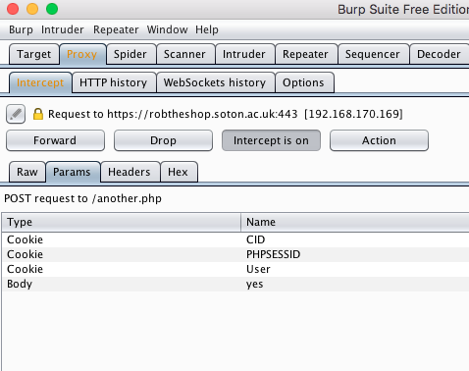
Cookies

Slide 31
What’s coming up…
You
Finish the Lab if you haven’t already
Get Burp Suite installed and set up and have a play
Me
The hacker mindset
More tools and techniques
Vulnerabilities in more detail

Slide 32
… and the first assignment!
Rob the Bank at https://robthebank.soton.ac.uk
You will receive an email today with a username and password to log in to Rob the Bank
For now, just take a look around – and we’ll dive in properly in the labs!

Slide 33
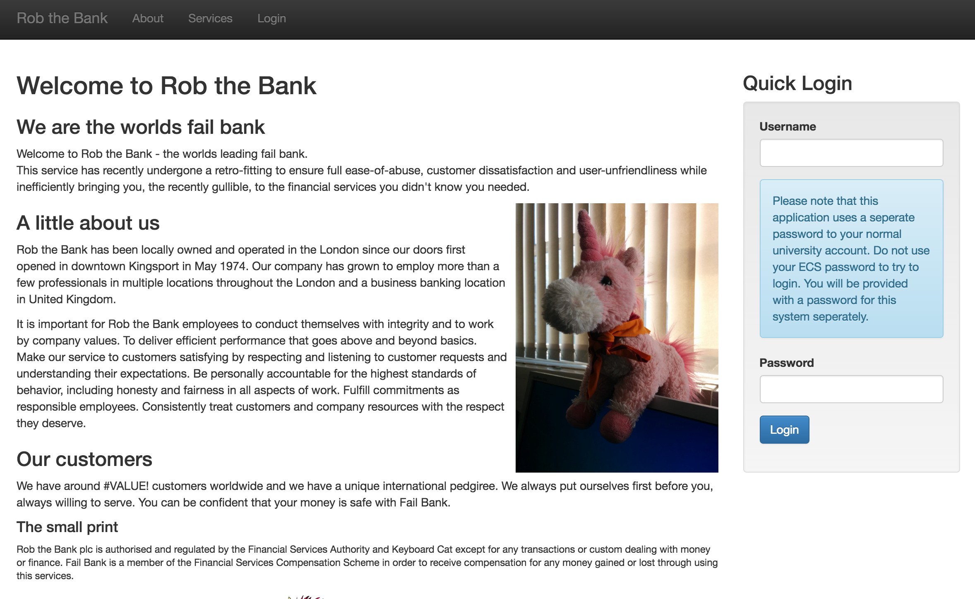

Slide 34
This week
Labs will run tomorrow and on Monday on Rob the Bank
We will not be using the Thursday lecture slot this week
We will be having a tutorial on Thursday at 5pm
This will be covering Rob the Shop and anything you’d like to go over in more detail
Let me know what you’d like me to cover!

Slide 35
Any questions?

